Slide 1
AI EXERCISES
MINH LE

Slide 2
FOR LOOPS
1/ PRINT all characters in “your name” by using for loops.
2/ Print all odd numbers x such that 1<=x<=10
3/ a/Compute the sum of all numbers in 2/
b/ Compute the sum of all number from 1 to 6.
4/ Given mydict={“a”: 1,”b”:2,”c”:3,”d”:4}.
a/ Print all key in mydict
b/ Print all values in mydict
c/ Print all keys and values

Slide 3
4/a/ for key in mydict:
print(key)
b/ for value in mydict.values():
print(value)
c/ for key,value in mydict.items():
print(key,value)

Slide 4
FOR LOOPS
5/ Given courses=[131,141,142,212] and names=[“Maths”,”Physics”,”Chem”, “Bio”]. Print a sequence of tuples, each of them contains one courses and one names
6/ Find the number of consonants in “jabbawocky” by two ways
a/ Directly (i.e without using the command “continue”)
b/ Check whether it’s characters are in vowels set and using the command “continue”
7/ a is a number such that -2<=a<3. Print out all the results of 10/a using try…except. When a=0, print out “can’t divided by zero”
8/ Given ages=[23,10,80]
And names=[Hoa,Lam,Nam]. Using lambda function to sort a list containing tuples (“age”,”name”) by increasing of the ages

Slide 5
6/ total =0
vowels=‘aeiou’
for char in “jabbawocky”:
if char in vowels:
continue
total +=1
print(total)

Slide 6
7/ for i in range(-2,3):
try:
print(10/i)
except ZeroDivisionError:
print(‘can’t divided by zero)
8/ sorted(zip(ages,names), key=lambda x : x[0])

Slide 7
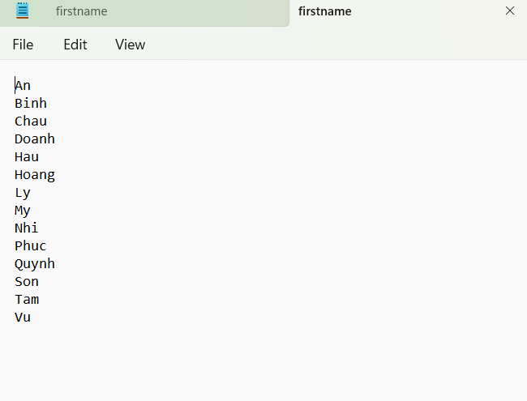
READ FILES
9/ Create a file “firstname.txt”:
a/ Open this file for reading
b/Print each line of this file
c/ Using .read to read the file and
Print it.

Slide 8
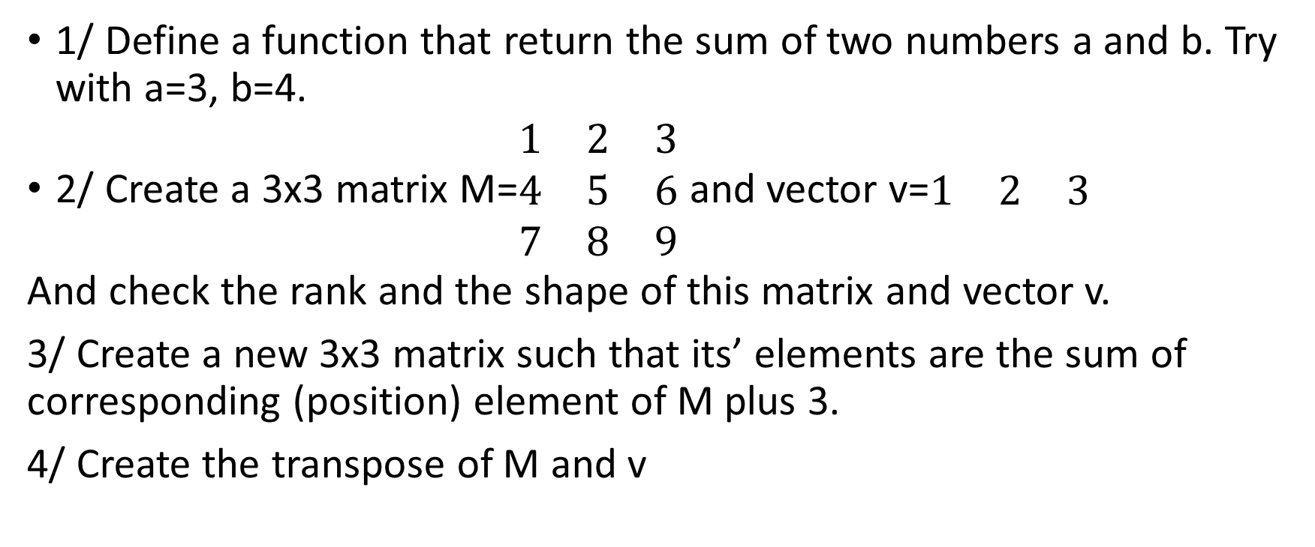
DEFINE A FUNCTION
1/ Define a function that return the sum of two numbers a and b. Try with a=3, b=4.
2/ Create a 3x3 matrix M=$\begin{matrix}1 & 2 & 3 \\ 4 & 5 & 6 \\ 7 & 8 & 9\end{matrix}$ and vector v=$\begin{matrix}1 & 2 & 3\end{matrix}$
And check the rank and the shape of this matrix and vector v.
3/ Create a new 3x3 matrix such that its’ elements are the sum of corresponding (position) element of M plus 3.
4/ Create the transpose of M and v

Slide 9
MATHS
5/ Compute the norm of x=(2,7). Normalization vector x.
6/ Given a=[10,15], b=[8,2] and c=[1,2,3]. Compute a+b, a-b, a-c.
7/ Compute the dot product of a and b.
8/ Given matrix A=[[2,4,9],[3,6,7]].
a/ Check the rank and shape of A
b/ How can get the value 7 in A?
c/ Return the second column of A.

Slide 10
MATHS
9/ Create a random 3x3 matrix with the value in range (-10,10).
10/ Create an identity (3x3) matrix.
11/ Create a 3x3 random matrix with the value in range (1,10). Compute the trace of this matrix by 2 ways:
a/ By one command
b/ By using for loops
12/ Create a 3x3 diagonal matrix with the value in main diagonal 1,2,3.
13/ Given A=[[1,1,2],[2,4,-3],[3,6,-5]]. Compute the determinant of A

Slide 11
MATHS
14/ Given a1=[1,-2,-5] and a2=[2,5,6]. Create a matrix M such that the first column is a1 and the second column is a2.
15/ Simply plot the value of the square of y with y in range (-5<=y<6).
16/ Create 4-evenly-spaced values between 0 and 32 (including endpoints)
17/ Get 50 evenly-spaced values from -5 to 5 for x. Calculate y=x**2. Plot (x,y).
18/ Plot y=exp(x) with label and title.
19/ Similarly for y=log(x) with x from 0 to 5.

Slide 12
MATHS
20/ Draw two graphs y=exp(x), y=exp(2*x) in the same graph and y=log(x) and y=log(2*x) in the same graph using subplot.

